Slide 1
Deterministic Finite Automata And Non-deterministic Finite Automata Session 04
Course : Comp6062 – Compilation Techniques
Effective Period : September 2018

Slide 2
Learning Outcomes
At the end of this Session, the student will be expected to:
Identify or define and explain DFA and NFA
Recognize and differentiate between DFA and NFA

Slide 3
Outline Material
An Informal picture of finite automata
Definition of DFA (Deterministic Finite Automata)
How a string DFA processes
The language of DFA
Definition of NFA (Non-Deterministic Finite Automata)
How a string DFA processes
Conversion of NFA to DFA

Slide 4
Finite Automata (1)
Finite State systems :
Deterministic Finite Automaton
Non-Deterministic Finite Automaton
Push Down Automata
Turing Machine
Linear Bounded Automata
ε- NFA
NFA
RE
DFA

Slide 5
Finite Automata (2)
General Example of Finite State Systems :
System Elevator
Switching circuit
Program text editor
Example 1 :
Man (m), Wolf (w), Goat (g),
Cabbage (c) crossing the river:
Start state : MWGC --- ∅
Final state : ∅ --- MWGC

Slide 6
Finite Automata (3)

Slide 7
Finite Automata (4)
Example 2 :
Protocol for e-commerce use e-money .
Allowed events :
The customer can pay the store (=send the money-file to the store)
The customer can cancel the money (like putting a stop on a check)
The store can ship the goods to the customer
The store can redeem the money (=cash the check)
The bank can transfer the money to the store.

Slide 8
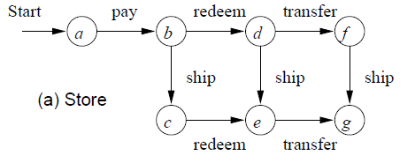
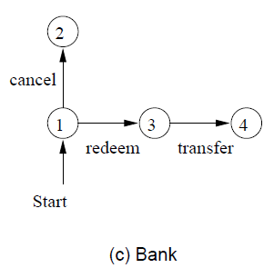
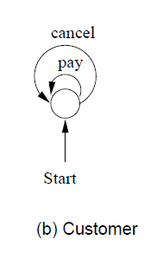
Finite Automata (5)
Protocol for each participant :

Slide 9
FINITE AUTOMATON (FA) :
Deterministic Finite Automaton – (DFA)
Mathematics model
Input Output Discrete
Configuration internal is called “State”
Transition betwen state on input symbol
Only one trasition of one state with a specifics input symbol (deterministic)
Directed Graph describes the FA called "Transition Diagram"

Slide 10
Definition of FINITE AUTOMATA
Formal definition : DFA is quintuple
M = (Q, ∑, σ, q₀, F)
where :
Q : Set of state
∑ : Alphabet input
q₀ ∈ Q : start / initial state
F ⊆ Q : Set of final state
σ : Q × ∑ : Transition function

Slide 11
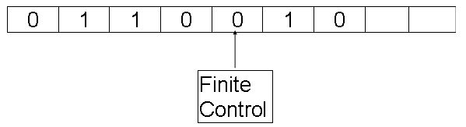
FINITE AUTOMATA
String input
σ (p, a)= q : in the state ‘p’, read input ‘a’ move to the state ‘q’

Slide 12

DETERMINISTIC FINITE AUTOMATA
Example :
DFA
Where the transitions are :
Presented in transition table :

Slide 13
DETERMINISTIC FINITE AUTOMATA
Example :
Lets design a DFA to accepts the language
L = {w| w has both an even number of 0’s and an even number of 1’s}
Tuples of DFA are:
Set of State (Q) : q₀, q₁, q₂, q₃
Start state : q₀
Final state (F) : q₀ {Double circle}
Alphabet input (Σ) : {0, 1}
State
0
1
→q₀*
q₂
q₁
q₁
q₃
q₀
q₂
q₀
q₃
q₃
q₁
q₂

Slide 14
DETERMINISTIC FINITE AUTOMATA
Design a DFA that accept the language
L = { w | w has an even number of 0’s following with an even number of 1’s} or
L = { (00)* (11)* }
0, 1
0
1
C
0
0
0
0
1
A
1
B
1
1

Slide 15
DETERMINISTIC FINITE AUTOMATA
Transition function for a String :
: Q × ∑* → Q
1. (q,∈) = q
{without reading the input symbol, can not change state }
2. For all string w and input a,
(q, wa) = σ( (q,w),a) = σ(p,a) → if p = (q,w)
For input w = a, σ and always in line :
(q,a) = σ( (q,∈),a) = σ(q,a)

Slide 16
FINITE AUTOMATA
(q,w) : is a state in which the FA will be after reading the string w, with start state q;
(q,w) = p, there is a path labeled w from state q to p.

Slide 17
FINITE AUTOMATA
STRING received/accepted :
String x received if (q₀,x) = p, p in F.
LANGUAGE received :
Language accepted by the FA-M is
{x⎮ (q₀,x) in F}
REGULAR LANGUAGE / SET :
Language accepted by an FA.

Slide 18
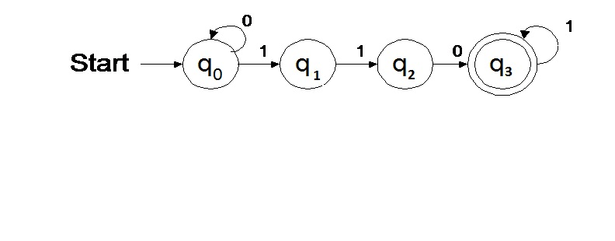
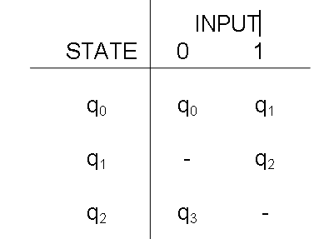
FINITE AUTOMATA
Example :
Q = {q₀,q₁,q₂,q₃}
∑ = {0,1}
F = {q₃}
σ : The following table is
described here in a function

Slide 19
FINITE AUTOMATA
Accepted String :
110, 01101, 00110111, …
RE : 0*1101*
Description Language
String which is made up of 110, may begin with a row of 0 and must end with row 1

Slide 20
Non Deterministic Finite Automata (NFA)
Definition of NFA :
There are more than one transition for the same input from the state.
Example :

Slide 21
Non Deterministic Finite Automaton (NFA)
String w is received : If there is a w-labeled path from start state to one of the final state, then w is received.
Example: Input : 01001
Note:
there may be more than one path labeled w but, there must be a path that ends in the final state, so that w accepted by the NFA .
q
0
q
1
q
0
q
0
q
1
q
0
0
0
0
0
0
0
1
0
0
1
q
q
q
q
q
3
1
3
3
0
0
q
1
q
: accept
4
4

Slide 22
Non Deterministic Finite Automaton (NFA)
Definition of Formal NFA :
M = (Q, ∑, σ, q₀, F)
where:
Q, ∑, q₀, F : such as the FA
σ : Q × ∑ → 2^{Q}
σ(q,a) : so there is a set of state p transition labeled a from q to p.

Slide 23
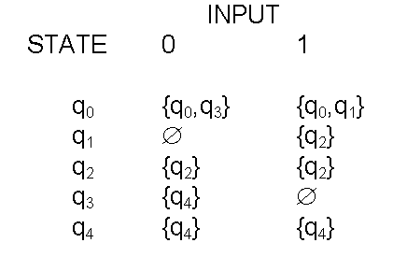
Non Deterministic Finite Automaton (NFA)
Transition function of NFA σ at above , can be writen as the following :
*
*

Slide 24
Non Deterministic Finite Automaton (NFA)
For String Transition :
: Q × ∑* → 2^{Q}
1. (q,∈) = {q}
2. (q,wa) = {p⎮r in (q,w), p in σ(r,a)}
: 2^{Q} × ∑* → 2^{Q} :
(P,w) = {q,w}, P ⊆ Q

Slide 25
Non Deterministic Finite Automaton (NFA)
Note : For input w = a
(q,a) = σ(q,a)
Language Accepted :
NFA M = (Q, ∑, σ, q₀, F),
L (M) = {w⎮ (q₀,w) ∈ F}

Slide 26
Non Deterministic Finite Automaton (NFA)
Example :
with the input: 01001
(q₀,0) = {q₀,q₃}
(q₀,01) = σ((q₀,0),1)
= σ({q₀,q₃},1)
= σ(q₀,1) ∪ σ(q₃,1)
= {q₀,q₁}
(q₀,010) = {q₀,q₃}
(q₀,0100) = {q₀,q₃,q₄}
(q₀,01001) = {q₀,q₁,q₄}
*
*

Slide 27
CONVERSION NFA TO DFA
Theorem :
If L is L (M) to an NFA, then the L received a DFA.
For every NFA M = (Q, ∑, σ, q_{o}, F), the Equivalence can be found DFA M1 = (Q¹, ∑¹, σ¹, q¹_{o}, F¹ ), which has the same language.
Where :
Q¹ = ∑^{Q} = Subset of Q
∑¹ = ∑q¹_{o} = q_{o}
σ¹ = σ¹([q₁, q₂, …, q_{i}] a) = [p₁, p₂, …, p_{j}]
If and only if σ ({q₁, q₂, …, q_{i}}, a) = {p₁, p₂,…, p_{j}}
F¹ = Formed from all over the state in Q¹ which contains one state in F

Slide 28
Example NFA to DFA conversion
State | 0 | 1
→q0 | {q0,q1} | q2
q1 | q0 | q1
* q2 | q1 | {q0,q1}
State | 0 | 1
→q0
{q0,q1}
{q2}
{q0,q1}
{q0,q1}
{q1,q2}
*{q2}
{q1}
{q0,q1}
*{q1,q2}
{q0,q1}
{q0,q1}
{q1}
{q0}
{q1}

Slide 29
1
{q1}
Diagram transition:
0
0
Start
{q0}
1
{q2}
1
0
1
{q1,q2}
{q0,q1}
0
0,1

Slide 30
Conversion NFA to DFA
Example : Change the following NFA into a DFA
NFA M = ({q₀, q₁}, {0, 1}, σ , q₀, { q₁})
Where the transition function σ :
σ(q₀, 0)={ q₀, q₁}; σ (q₀, 1) = { q₁ }
σ(q₁, 0)= ∅ ; σ(q₁, 1) = { q₀, q₁}
STATE | Input 0 | Input 1
{q0} | {q0,q1} | {q1}
{q0,q1} | {q0,q1} | {q0,q1}
{q1} | ∅ | {q0,q1}

Slide 31
Conversion NFA to DFA
Transition diagram of DFA:
1
{q0,q1}
0
{q0}
{q0}
1
{q1}
0,1

Slide 32
Exercise
Convert to DFA the following NFA:
1. 2.
State | 0 | 1
→p | {p, q} | {p}
q | {r} | {r}
r | {s} | -
*s | {s} | {s}
State | 0 | 1
→p | {p, q} | {p}
q | {r, s} | {t}
r | {p, r} | {t}
*s | - | -
*t | - | -

Slide 33
References
Hopcroft, John E., Motwani, Rajeev, Ullman, Jeffrey D. (2007). Introduction to automata theory, languages, and computation. 3rd. Addison-Wesley. New York. ISBN: 9780321476173, Chapter 2.1, 2.2, and 2.3 (page 37-66)
Aho, A.V., Ravi, S., & Ullman, J.D. (2007). Compiler : Principle, techniques and tools. 2nd. Addison-Wesley. New York. ISBN : 0321491696, Chapter 3.6, and 3.7 (page 147-166)
http://www.eecs.wsu.edu/~ananth/CptS317/Lectures/FiniteAutomata.pdf

